Slide 1
MySQL Kickstarter Course:
CFG Streaming Project
Prepared by: Nadya Valkova

Slide 2
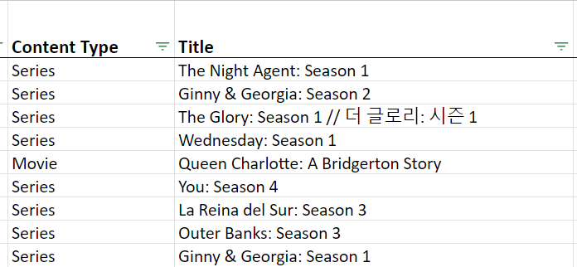
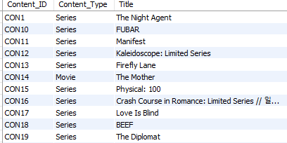
Step 1: Normalising the input
Real data from Netflix (What We Watched: A Netflix Engagement Report)
Normalised (& simplified!) the data such as:
FROM:
TO:

Slide 3
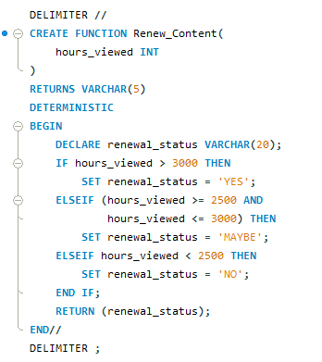
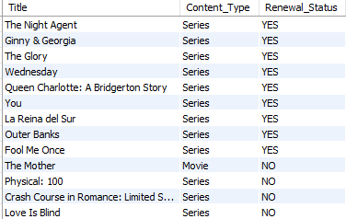
Step 2: Ran some queries :)
Such as… Which title should be renewed for a new season / movie sequel? (using a stored function, and setting the condition for >3000 average hours viewed)
INPUT:
OUTPUT:

Slide 4
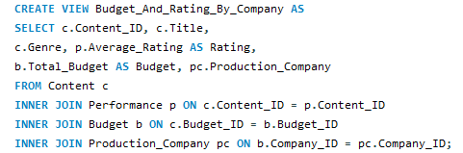
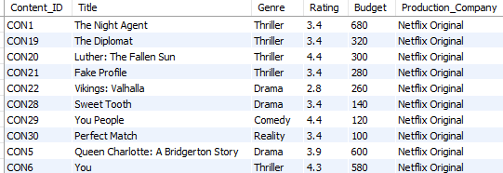
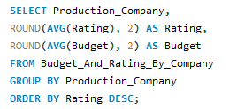

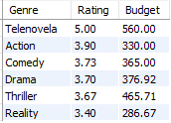
Step 3: Ran some advanced queries :)
Such as… A view that combines Genre, Total Budget, Rating and Production Company, all coming from different tables.
INPUT:
OUTPUT:

Slide 5
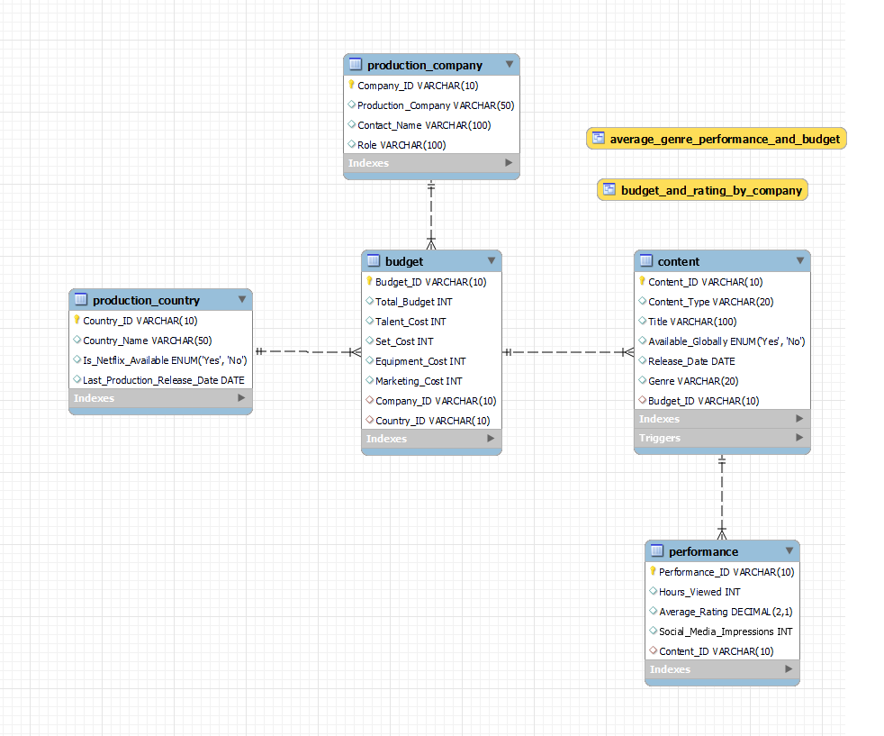
Project
Snapshot
5 Tables with Primary Keys
3 with Foreign Keys
8 Queries ran
2 Views
1 Stored Function
1 Trigger

Slide 6
Thank you to Rui and Nour!

